Slide 1


ASP.NET Core structure
Speaker:
Ivan Hlabets

Slide 2

Agenda
Overview
Types of applications
General ASP.NET Core architecture
The Startup class
Dependency Injection
Middleware
Host
Servers
Configuration and Options
Environments
Logging
Routing

Slide 3
Agenda
Handle errors
Filters
Web API overview
Swagger
Action return types
Format response data
Authentication and authorization
WebSockets
Data access
Hosting and deployment
Validation and versioning

Slide 4
Benefits
- A unified story for building web UI and web APIs.
- Architected for testability.
Razor Pages makes coding page-focused scenarios easier and more
productive.
Blazor lets you use C# in the browser alongside JavaScript.
Share server-side and client-side app logic all written with .NET.
- Ability to develop and run on Windows, macOS, and Linux.
- Open-source and community-focused.
- A cloud-ready, environment-based configuration system.
- Built-in dependency injection.
A lightweight, high-performance, and modular HTTP request
pipeline.
Ability to host on IIS, Nginx, Apache, Docker, or
self-host in your own process.
- Side-by-side app versioning when targeting .NET Core.
- Tooling that simplifies modern web development.

Slide 5
Types of applications
Traditional Web Application - UI application logic is performed on the server side.
Single Page Application - UI logic is performed at the client (web browser) side and server side is communicated primarily for data processing through Web API calls.
The list of project templates that ASP.NET Web Core provides:
- ASP.NET Core Web App (Razor Pages)
- ASP.NET Core Web App (Model-View-Controller)
- ASP.NET Core Web API (no UI)
- ASP.NET Core with Angular (SPA)
- ASP.NET Core with React.js (SPA)
ASP.NET Core with React.js and Redux (SPA)
Tutorials:
https://docs.microsoft.com/en-gb/aspnet/core/?view=aspnetcore-2.2

Slide 6
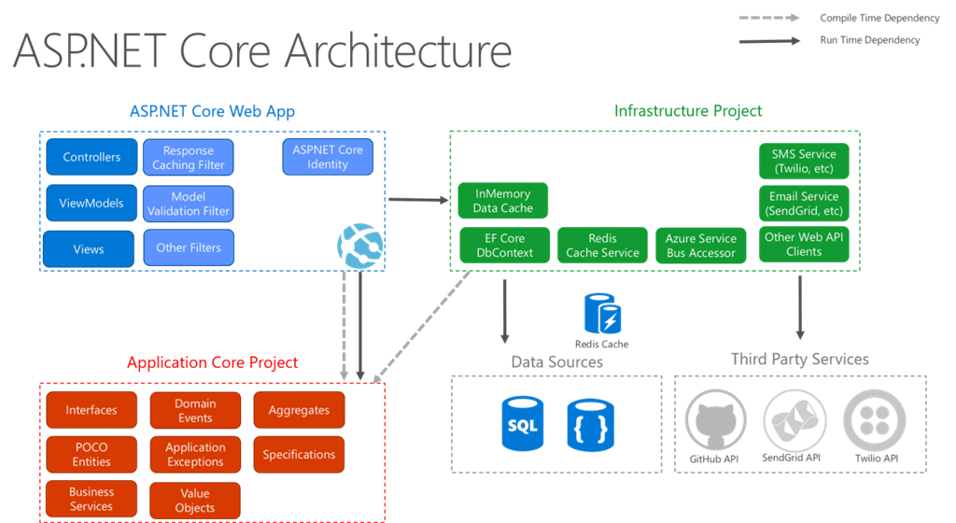

Slide 7
The Startup class
The Startup class is where:
- Services required by the app are configured.
The request handling pipeline is defined.
Services are components that are used by the app. For example, a logging component is a service. Code to configure (or register) services is added to the Startup.ConfigureServices method.
The request handling pipeline is composed as a series of middleware components.
Info:
https://docs.microsoft.com/en-gb/aspnet/core/fundamentals/startup?view=aspnetcore-2.2

Slide 8
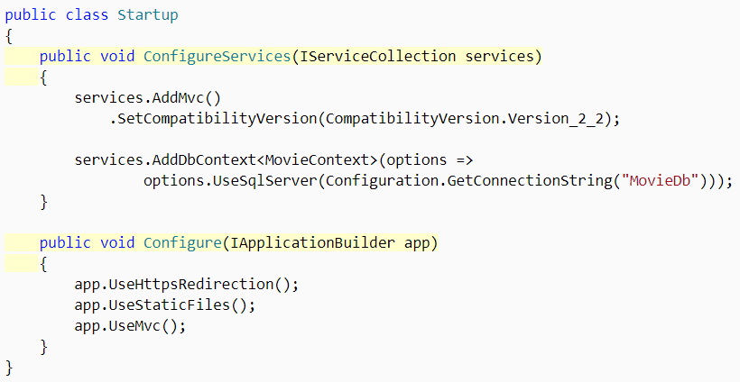
The Startup class

Slide 9
Dependency Injection
ASP.NET Core supports the built-in dependency injection (DI) software design pattern, which is a technique for achieving Inversion of Control (IoC) between classes and their dependencies. It makes configured services available to an app's classes.
One way to get an instance of a service in a class is to create a constructor with a parameter of the required type. The parameter can be the service type or an interface. The DI system provides the service at runtime.
Dependency injection benefits:
- The use of an interface to abstract the dependency implementation.
- Registration of the dependency in a service container. ASP.NET Core provides a built-in service container, IServiceProvider. Services are registered in the app's Startup.ConfigureServices method.
- Injection of the service into the constructor of the class where it's used. The framework takes on the responsibility of creating an instance of the dependency and disposing of it when it's no longer needed.
Info:
https://docs.microsoft.com/en-gb/aspnet/core/fundamentals/dependency-injection?view=aspnetcore-2.2

Slide 10
Dependency Injection
Choose an appropriate lifetime for each registered service. ASP.NET Core services can be configured with the following lifetimes:
- Transient - services are created each time they're requested from the service container. This lifetime works best for lightweight, stateless services.
- Scoped - services are created once per client request (connection).
Singleton - services are created the first time they're requested (or when ConfigureServices is run and an instance is specified with the service registration). Every subsequent request uses the same instance. If the app requires singleton behavior, allowing the service container to manage the service's lifetime is recommended.
Services can be resolved by two mechanisms:
- IServiceProvider
- ActivatorUtilities – Permits object creation without service registration in the dependency injection container. ActivatorUtilities is used with user-facing abstractions, such as Tag Helpers, MVC controllers, and model binders.

Slide 11
Middleware
Middleware is software that's assembled into an app pipeline to handle requests and responses. Each component:
- Chooses whether to pass the request to the next component in the pipeline.
Can perform work before and after the next component in the pipeline.
Request delegates are used to build the request pipeline. The request delegates handle each HTTP request.
Request delegates are configured using Run, Map, and Use extension methods. An individual request delegate can be specified in-line as an anonymous method (called in-line middleware), or it can be defined in a reusable class. These reusable classes and in-line anonymous methods are middleware, also called middleware components. Each middleware component in the request pipeline is responsible for invoking the next component in the pipeline or short-circuiting the pipeline. When a middleware short-circuits, it's called a terminal middleware because it prevents further middleware from processing the request.
Info:
https://docs.microsoft.com/en-gb/aspnet/core/fundamentals/middleware/?view=aspnetcore-2.2

Slide 12
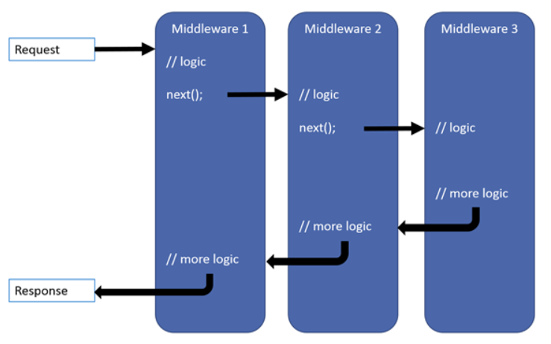
Middleware

Slide 13
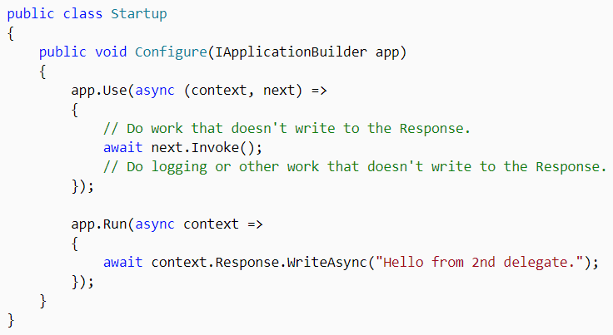
Middleware

Slide 14
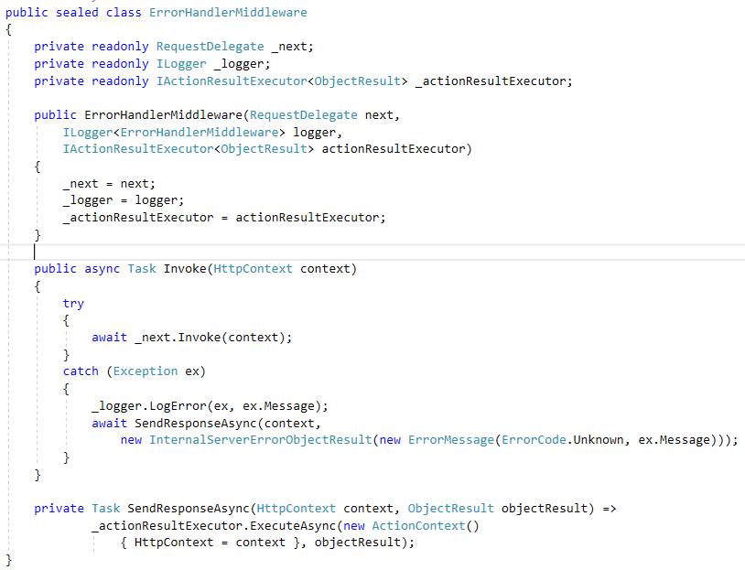
Middleware

Slide 15
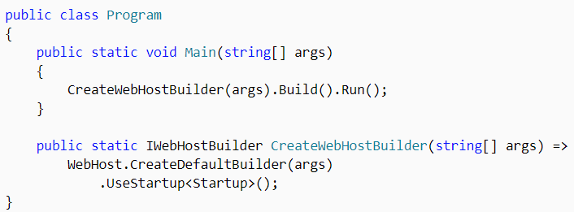
Host
ASP.NET Core apps configure and launch a host. The host is responsible for app startup and lifetime management. At a minimum, the host configures a server and a request processing pipeline. The host can also set up logging, dependency injection, configuration, and encapsulates all of the app's resources.
Info:
https://docs.microsoft.com/en-gb/aspnet/core/fundamentals/host/web-host?view=aspnetcore-2.2

Slide 16
Host
CreateDefaultBuilder performs the following tasks:
- Configures Kestrel server as the web server using the app's hosting configuration providers.
- Sets the content root to the path returned by Directory.GetCurrentDirectory.
- Loads host configuration.
- Loads app configuration.
- Configures logging for console and debug output
- When running behind IIS with the ASP.NET Core Module, CreateDefaultBuilder enables IIS Integration, which configures the app's base address and port.
- Sets ServiceProviderOptions.ValidateScopes to true if the app's environment is Development.

Slide 17
Servers
An ASP.NET Core app uses an HTTP server implementation to listen for HTTP requests. The server surfaces requests to the app as a set of request features composed into an HttpContext.
ASP.NET Core provides the following server implementations:
- Kestrel is a cross-platform web server. Kestrel is often run in a reverse proxy configuration using IIS. In ASP.NET Core 2.0 or later, Kestrel can be run as a public-facing edge server exposed directly to the Internet.
- IIS HTTP Server is a server for windows that uses IIS. With this server, the ASP.NET Core app and IIS run in the same process.
- HTTP.sys is a server for Windows that isn't used with IIS.
Info:
https://docs.microsoft.com/en-gb/aspnet/core/fundamentals/servers/?view=aspnetcore-2.2&tabs=windows

Slide 18
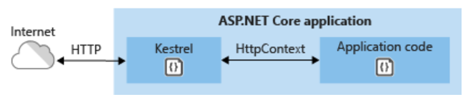
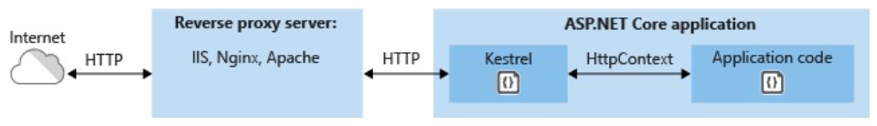
Servers
Use Kestrel by itself as an edge server processing requests directly from a network, including the Internet.
Use Kestrel with a reverse proxy server. A reverse proxy server receives HTTP requests from the Internet and forwards them to Kestrel.

Slide 19
Configuration
ASP.NET Core provides a configuration framework that gets settings as name-value pairs from an ordered set of configuration providers. There are built-in configuration providers for a variety of sources, such as .json files, .xml files, environment variables, and command-line arguments. You can also write custom configuration providers.
Host configuration is provided from environment variables prefixed with ASPNETCORE_ and command-line arguments.
App configuration is provided from appsettings.json, environment variables and command-line arguments.
Info:
https://docs.microsoft.com/en-gb/aspnet/core/fundamentals/configuration/?view=aspnetcore-2.2

Slide 20
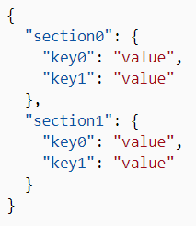
Configuration
Adopt the following best practices:
- Never store passwords or other sensitive data in configuration provider code or in plain text configuration files.
- Don't use production secrets in development or test environments.
- Specify secrets outside of the project so that they can't be accidentally committed to a source code repository.

Slide 21

Thank you!

